Slide 1
Timeline of Educational Influences
Bram Walker, T00633126
EDEF 3100_02
Dr. Brad Harasymchuk
Thompson Rivers University
September 21, 2023

Slide 2





My Path To Teaching
The Inspiration
High School History Teacher
The Gamble
I moved to Kamloops to live a life of adventure
The Decision
The Turning Point
I resolved to become a teacher
I began living a better life and enrolled at TRU
The Confirmation
A positive experience at work reinforced my decision

Slide 3
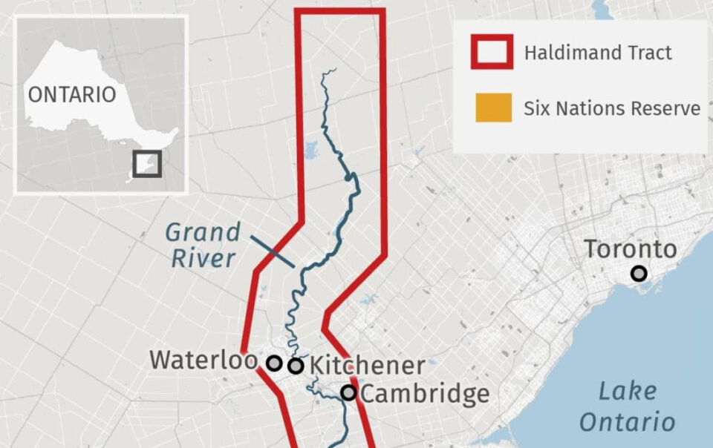
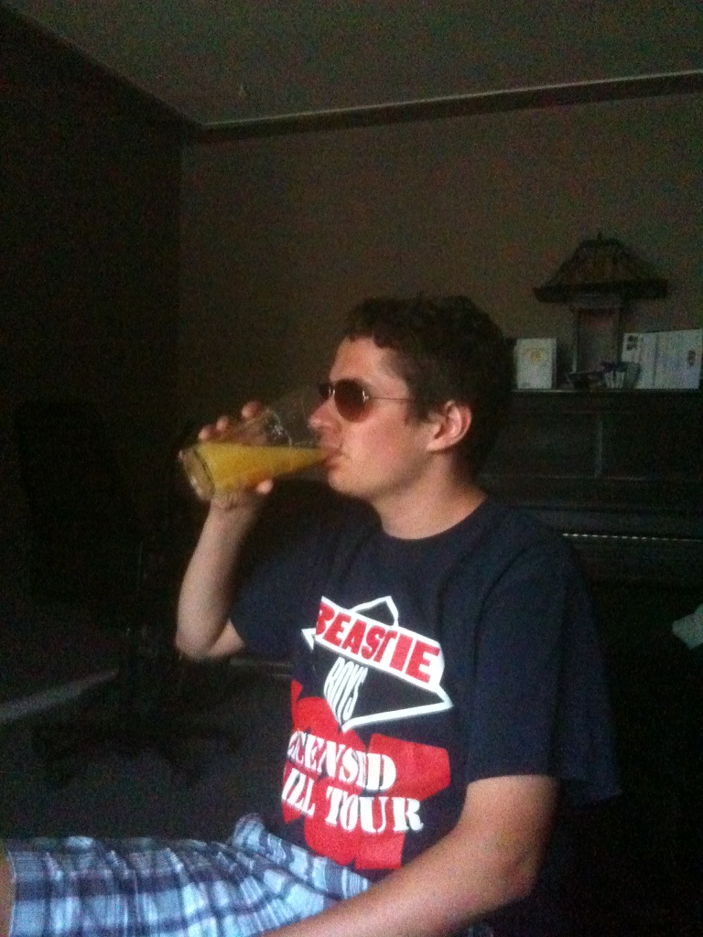
The Inspiration
I went to high school in Waterloo, Ontario which is located within the Haldimand Tract of the Haudenosaunee Confederacy. My history teacher, Mr. Peters, noticed my interest in the subject and told me that I might be able to teach history. This planted the seed in my head that one day I might become an educator. Looking back on this important person in my development, I realize that I would like to emulate his incorporation of media and story into lessons to make the subject interesting and inspire others to teach.
Google Map

Slide 4
My Path To Teaching
The Inspiration
High School History Teacher
The Gamble
I moved to Kamloops to live a life of adventure
The Decision
The Turning Point
I resolved to become a teacher
I began living a better life and enrolled at TRU
The Confirmation
A positive experience at work reinforced my decision

Slide 5
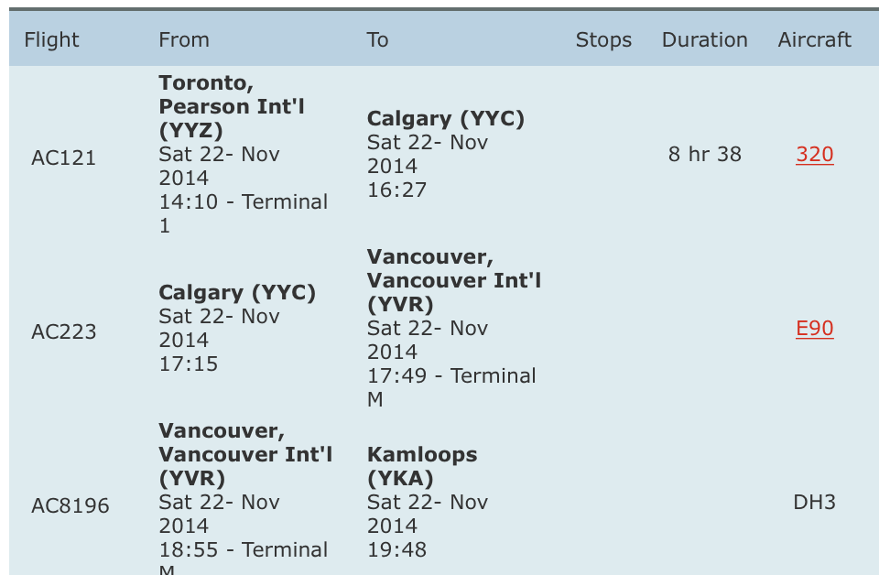
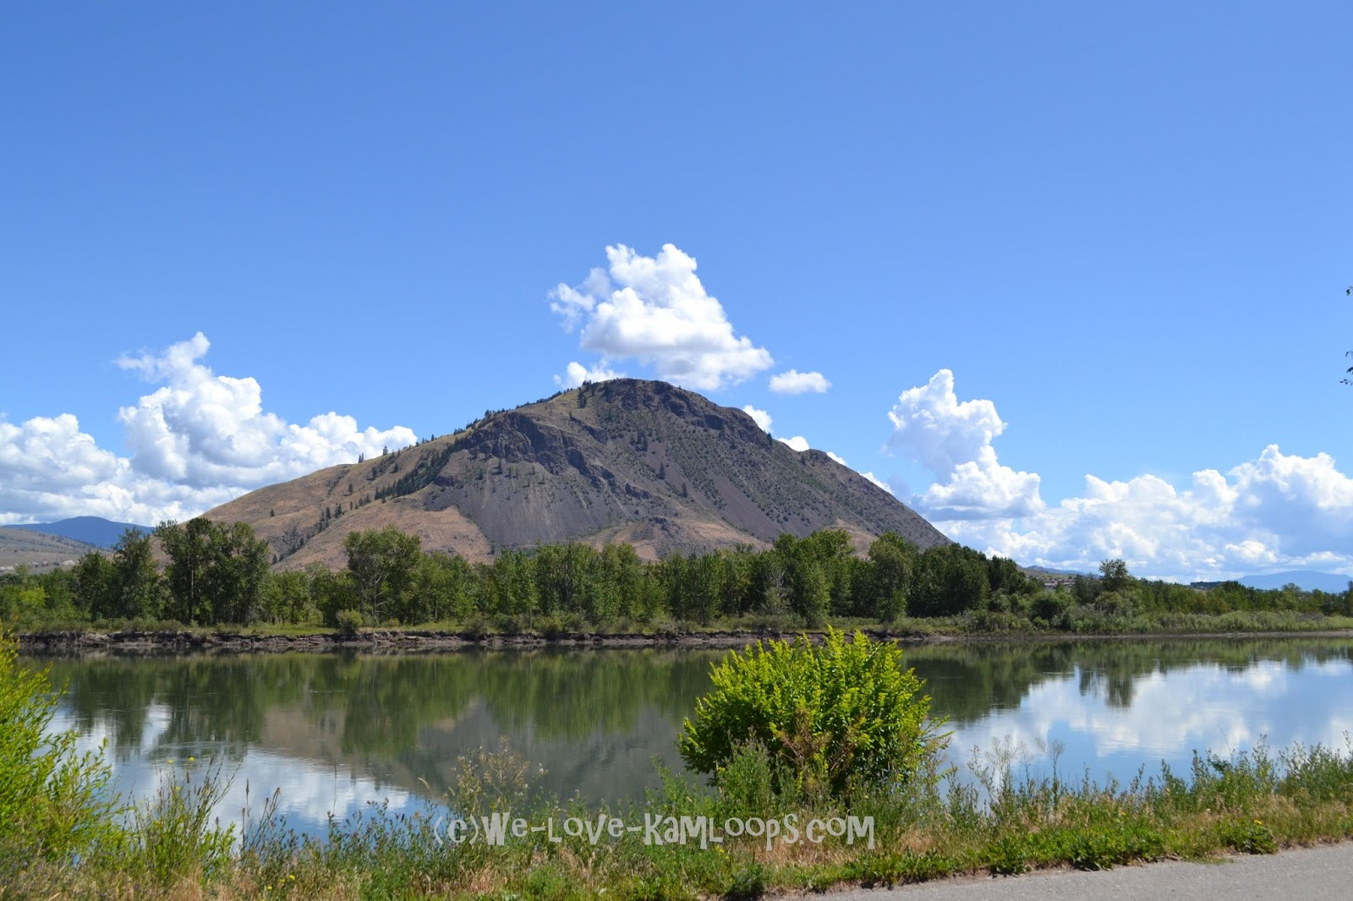
The Gamble
About 8 years ago, I was invited to move to Kamloops by my good friend. I had only visited BC once before, but I was determined to experience new things in a land that had no shortage of nature or adventure. I often think that if I had not taken this step that I would not have met my girlfriend, attended TRU, or have applied for this program. Being in Kamloops has enriched my cultural understanding and I now plan to follow a career in education here in BC.

Slide 6
My Path To Teaching
The Inspiration
High School History Teacher
The Gamble
I moved to Kamloops to live a life of adventure
The Decision
The Turning Point
I resolved to become a teacher
I began living a better life and enrolled at TRU
The Confirmation
A positive experience at work reinforced my decision

Slide 7

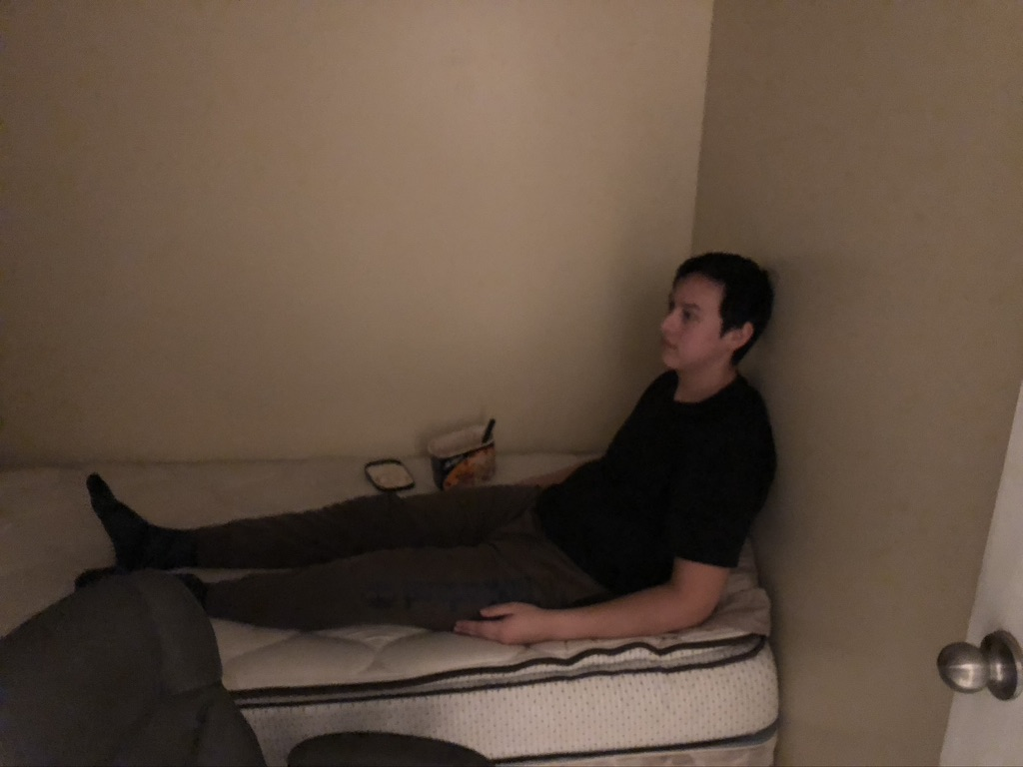

The Turning Point
I appreciated my new life in Kamloops, but I had not planned for my future. I was working minimum wage jobs and renting out an actual closet. This difficult situation was in many ways the turning point of my life, where I decided that I wanted to contribute and achieve more. I got a job with the Kamloops Film Society, started living a healthier lifestyle, and enrolled at TRU. I now have a hard time relating to the person who I was before this point, because I really feel that my mentality has changed drastically from this point

Slide 8
My Path To Teaching
The Inspiration
High School History Teacher
The Gamble
I moved to Kamloops to live a life of adventure
The Decision
The Turning Point
I resolved to become a teacher
I began living a better life and enrolled at TRU
The Confirmation
A positive experience at work reinforced my decision

Slide 9

The Decision
  After spending a few years in the Bachelor of Arts: History program, I was living a much more fulfilling life. One day while walking down the street, it suddenly struck me that I wanted to become a teacher. I don’t know how it happened, but at that moment I committed myself 100% to this goal. I knew that if I was able to reach this goal I would be able to support my girlfriend and I, while also having the opportunity to inspire others like Mr. Peters had for me.
Google Map

Slide 10
My Path To Teaching
The Inspiration
High School History Teacher
The Gamble
I moved to Kamloops to live a life of adventure
The Decision
The Turning Point
I resolved to become a teacher
I began living a better life and enrolled at TRU
The Confirmation
A positive experience at work reinforced my decision

Slide 11


The confirmation
  My new job at BGC Kamloops was an eye-opening experience for me. A certain child in our summer program had severe behavioural problems at the beginning of camp, but by the end of the summer has remarkable improvements in social behaviour. It was a small example of the positive change that we can make with children and it re-inforced my belief that I was on the right career track. I can now move forward with the self-belief that if I do my best I can leave positive impacts on everyone that I work with as a teacher.

Slide 12
Thanks for listening!

