Slide 1

WHY FOUNDATIONS OF EDUCATION MATTER
Bram, Jordan, Mike
Notes:
Good morning. We’re Bram, Jordan, and Mike, and we’re going to go through a presentation based upon the first chapter in Hasinoff and Mandzuk’s book “Case studies in educational foundations: Canadian perspectives.” This chapter of the book is entitled “Why the Foundations of Education Matter”

Slide 2
LAND ACKNOWLEDGEMENT & FIRST PEOPLES PRINCIPLES OF LEARNING
WELL-BEING
HISTORY
Self, family, community
Past practices
IDENTITY
PHILOSOPHY
Connection to others and land
Learn from inquiry
HOLISTIC
SOCIOLOGY
Pay attention to the whole learner
How individuals and society interact
Notes:
We want to acknowledge that we are presenting today from the traditional, unceded territory of the Tk’emlups te Secwepemc.
We are uninvited guests on the land, and acknowledge the that knowledge of historical injustices will be foundational to our future classrooms.
As Joanne Chrona notes:
The first peoples principles of learning include the fact that there are diverse learning styles and needs among all learners. There isn’t a separation between the concept of education and the rest of a person’s experience. And furthermore, heritage and culture are complex constructs.
We will see throughout this presentation that teacher candidates benefit from reflecting on history, philosophy, and sociology of education to improve their teaching, and this is interwoven in the First Peoples principles of learning as well.

Slide 3
CONTENTS OF PRESENTATION
PASSAGES
Significance of two key passages
SUMMARY
CREATIVITY
Essay’s purpose and message
Drawing & Webbing Map
QUESTIONS
ACTIVITY
Two remaining questions
Reinforce learning from essay
Notes:
We’re going to summarize the essay, and point out its message.
We’ll highlight a couple of key passages, and some of the remaining questions we have after reading it.
We’ll also visually show the essay’s content in a drawing and a webbing map that shows the connections between important ideas, thoughts, and words contained in the essay.
Finally, we’ll have you participate in small groups in an activity that is designed to get you thinking about the importance of reflecting on the history, philosophy, and sociology of education for developing your teaching philosophy. We hope that through the activity you’ll see different perspcectives from peers, as well as being forced to contemplate alternative views from your existing ones to help you to refine or entrench your beliefs, with respect to the essay’s message.

Slide 4
SUMMARY OF THE ESSAY
01
02
03
HISTORY
UNDERSTANDING
CONSTRAINTS
is a Roadmap
and Critical Thinking
of Education
04
05
06
QUESTIONS
SCHOOLS’
DIVERSITY
Collaborative and open-ended
Norms, roles, practices, and structures
of Experiences and Opportunities

Slide 5
TWO KEY PASSAGES
PLIGHT OF THE RURAL TEACHER
NOT A TIME TO COMMIT SOCIOLOGY
Mabel Jones (pg. 5)
Stephen Harper (pg. 12)

Slide 6
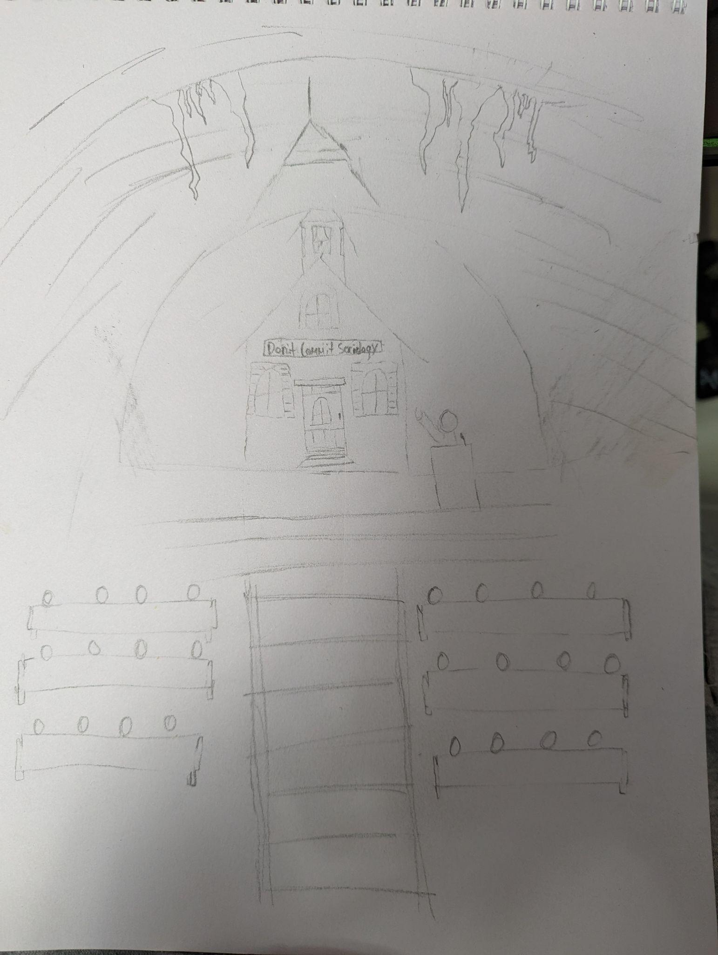
ESSAY IN PICTORIAL FORM

Slide 7
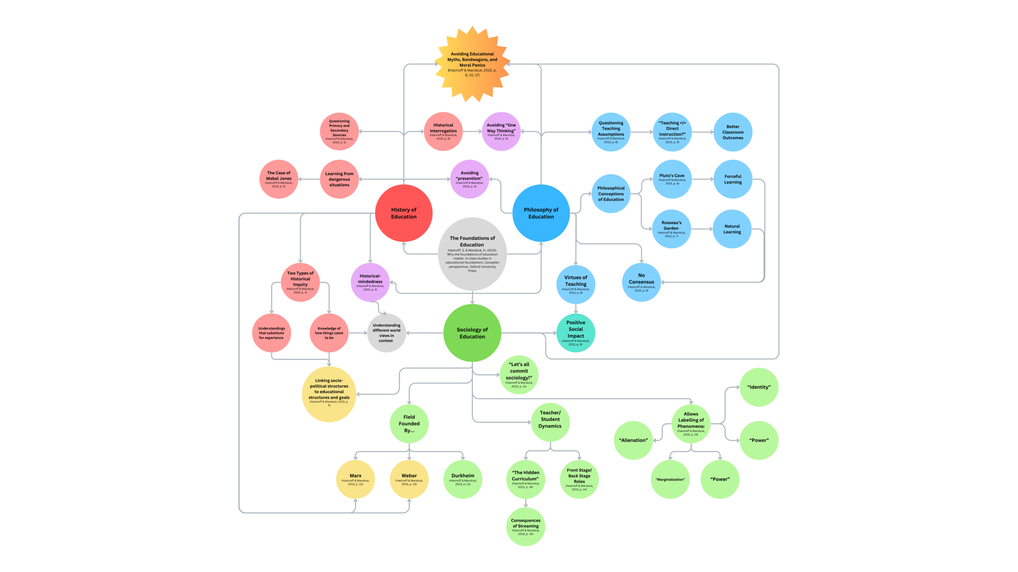
WEBBING MAP

Slide 8
TWO REMAINING QUESTIONS
QUESTION 1
QUESTION 2
What are the “myths, bandwagons, and moral panics” that the author repeatedly mentions
in the text?
How can teacher candidates incorporate philosophies which might be categorized as Indigenous or Eastern into their teaching?

Slide 9
THREE KEY TERMS
01
02
03
STAGE
HIDDEN
CURRICULUM
HISTORICAL
MINDEDNESS

Slide 10
SUMMARY & CONCLUSION
01
OVERVIEW
02
05
KEY PASSAGES
YOUR QUESTIONS
03
04
PINK PONY PICASSOS
OUR REMAINING QUESTIONS
Notes:
We reviewed and summarized the essay. Jordan discussed the key messages of the essay, and its purpose.
He then shared two key passages involving the rural teacher and the politicization of education.
After that we saw the rendition of the essay in pictorial form in the drawing of the cave, one-room schoolhouse chimney, and train tunnel.
Next Bram shared the webbing map that showed the connections between key ideas and words found within the essay.
Finally we left you with questions that still remain after reading the essay.
Now it’s your turn to ask us questions about either the essay or presentation before we move into an activity.

Slide 11
ACTIVITY TIME
POP
HIP HOP
Foster the People
High School Musical
Dead Prez
Nas
MUSIC GENRE
ROCK
R & B
ALTERNATIVE
38 Special
Alice Cooper
Pink Floyd
Kelly Rowland
Weird Al
Morrissey
Weezer
Notes:
We’re going to have a discussion amongst table groups. The purpose is to apply some of the chapters context to our actual future classrooms and teaching philosophies. Come up with arguments that both agree and disagree with the song lyrics you’ve been given.
You’ll note at the bottom of each page are some questions to generate some thoughts for your discussion. You can choose to answer those questions, or take your discussion in another direction. What is important is to make arguments in favour and against the lyrics of the song you’ve been provided.
At the end we’ll come back to the larger group and you’ll read your lyrics and quickly summarize an argument that backs up the lyrics and another that opposes them.
I have more songs than we’ll be able to look at, so if you want to let me know your preferred genre or artist, I will give you that set of lyrics.
Any questions?

Slide 12
ESSAY CONCEPTS FOR GROUP DISCUSSION
HISTORY
FAMILIARITY WITH PAST PRACTICES HELPS US EMERGE FROM EDUCATIONAL FORGETFULNESS
HOW CERTAIN PROGRAMS & POLICIES EMERGED OVER TIME
SOCIOECONOMIC AND MULTICULTURAL CHANGES WITHIN SCHOOLS
AVOID PRESENTISM (INTERPRETING PAST ACCOUNTS AS IF THEY HAPPENED TODAY)
PHILOSOPHY
LONG-STANDING DEBATE AND DISAGREEMENT ABOUT EDUCATION
ARE THERE WIDESPREAD AND AGREED-UPON FACTS ABOUT EDUCATION?
OUR PERSPECTIVE AND TEACHING PHILOSOPHY IMPACTS NOT ONLY STUDENT LEARNING, BUT THEIR TRUST IN US
SOCIOLOGY
EDUCATION IS CENTRAL TO HUMAN EXPERIENCE
SCHOOLS CAN TEACH AND REINFORCE SOCIETAL NORMS AND VALUES
THE SAME EXPERIENCES CAN HAVE DIFFERENT IMPACTS
CRITICAL THINKING SKILLS ARE NEEDED IN RESPONSE TO MYTHS, BANDWAGONS, & MORAL PANICS
Notes:
Here are some of the essay’s concepts to think about when having your discussions

Slide 13

WORKS CITED
Hasinoff, S. & Mandzuk, D. (2015). Why the foundations of education matter. In Case studies in
educational foundations: Canadian perspectives. Oxford University Press.
Notes:
Here are some of the essay’s concepts to think about when having your discussions

Slide 14


